Slide 1
R M Inbarasu
Final Project
3/21/2024 Annual Review

Slide 2
PROJECT TITLE
Image Generation Using GAN Gen AI Project
3/21/2024 Annual Review

Slide 3


AGENDA
Introduction to Generative Adversarial Networks (GANs)
Problem Statement
Project Overview
End Users
Solution and Value Proposition
Innovative Features
Modelling
Results and Evaluation
3/21/2024 Annual Review

Slide 4

PROBLEM STATEMENT
Generating high-quality images that resemble real-world photographs or artwork has been a challenge in the field of artificial intelligence. Traditional methods often produce blurry or unrealistic images. The need for a system that can generate high-fidelity images with diverse styles and contents is crucial for various applications like art creation, image editing, and content generation.
3/21/2024 Annual Review

Slide 5

PROJECT OVERVIEW
Our project focuses on implementing a Generative Adversarial Network (GAN) to generate high-resolution images that closely resemble real photographs or artistic images. The GAN architecture consists of two neural networks: a generator and a discriminator. The generator learns to create realistic images, while the discriminator learns to distinguish between real and fake images.
3/21/2024 Annual Review

Slide 6

WHO ARE THE END USERS?
Artists and designers looking for inspiration and content generation
Photographers seeking to enhance or manipulate images
Content creators and marketers for generating visual content
Researchers exploring generative models for creative applications
3/21/2024 Annual Review

Slide 7

YOUR SOLUTION AND ITS VALUE PROPOSITION
Our solution leverages GAN technology to generate high-quality images with realistic details and diverse styles. The value proposition includes:
High-fidelity image generation
Diverse style and content creation
Seamless integration into existing creative workflows
Potential for personalized content generation
3/21/2024 Annual Review

Slide 8

THE WOW IN YOUR SOLUTION
Adaptive training techniques for improved image quality
Style mixing capabilities for creating hybrid images
Interactive controls for users to guide image generation Transfer learning for fine-tuning the model to specific domains
3/21/2024 Annual Review
8

Slide 9
MODELLING
Teams cam add wireframes
Architecture: Deep Convolutional GAN (DCGAN), StyleGAN, or their variants
Training data: Diverse datasets containing real-world images
Loss functions: Adversarial loss, perceptual loss, and feature matching loss
Optimization techniques: Gradient descent-based methods with regularization
3/21/2024 Annual Review
9

Slide 10
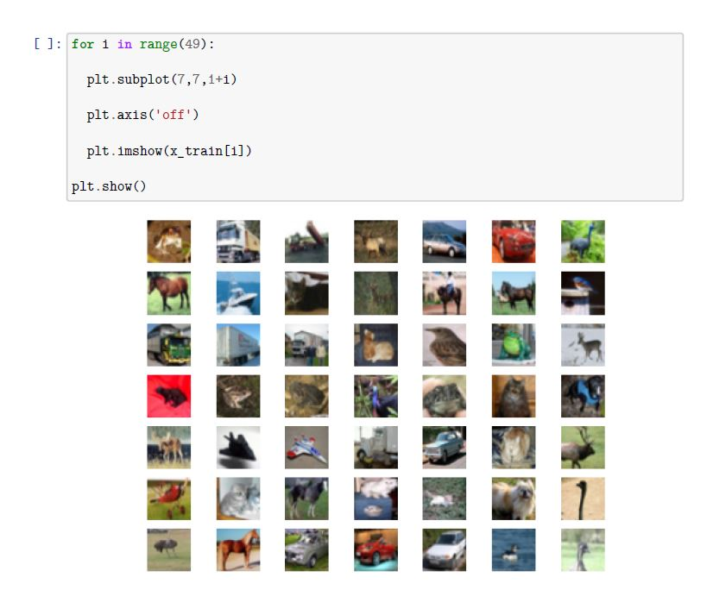
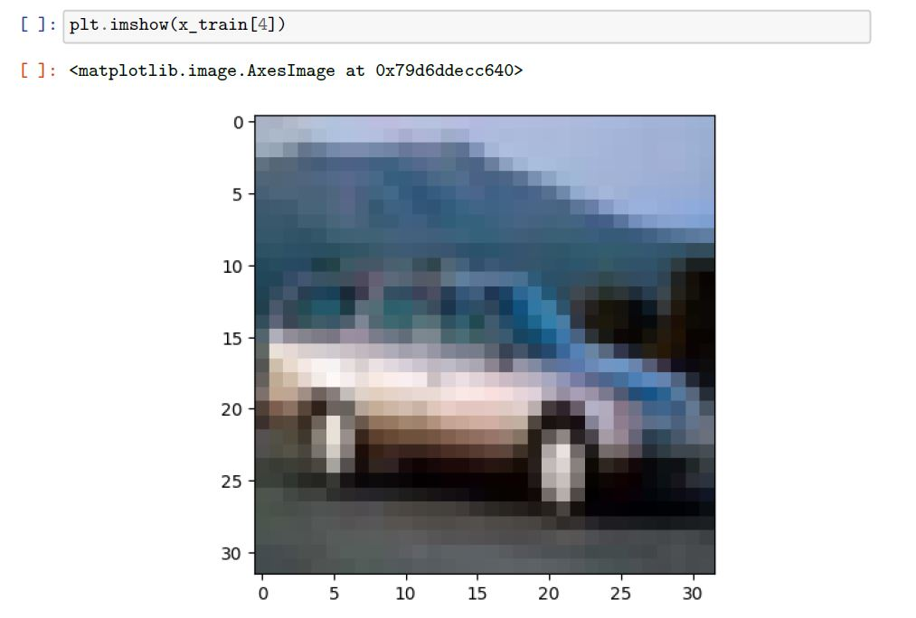
RESULTS
Demo Link
3/21/2024 Annual Review
10

